Slide 1
Managing Projects
Project Planning and Acquisition

Slide 2
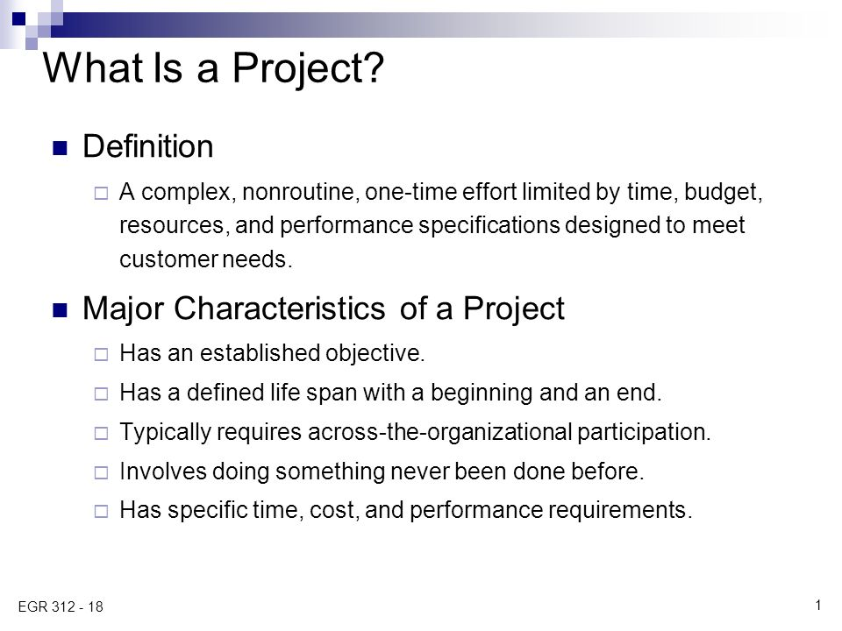

Slide 3
Characteristics of Project
A project represents a collection of tasks aimed toward a single set of objectives, culminating in a definable end point and having a finite life span and budget.
A project is a one-of-a-kind activity, aimed at producing some product or outcome that has never existed before.
In contrary, a “program” is a more comprehensive undertaking, which may in turn consist of a number of projects.

Slide 4
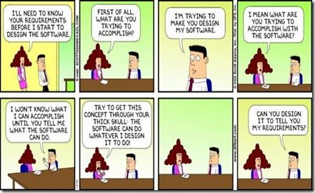

Slide 5
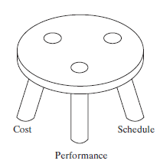
The “three-legged-stool” of successful project management
Time (project schedule)
Cost
Performance and quality
The successful project manager will attempt to keep these three in balance.
To achieve this balance, all projects will have scope, schedule, and budget
Since achieving maximum performance is often possible only at the expense of cost and schedule, difficult trade-off decisions involving compromises are often necessary.

Slide 6
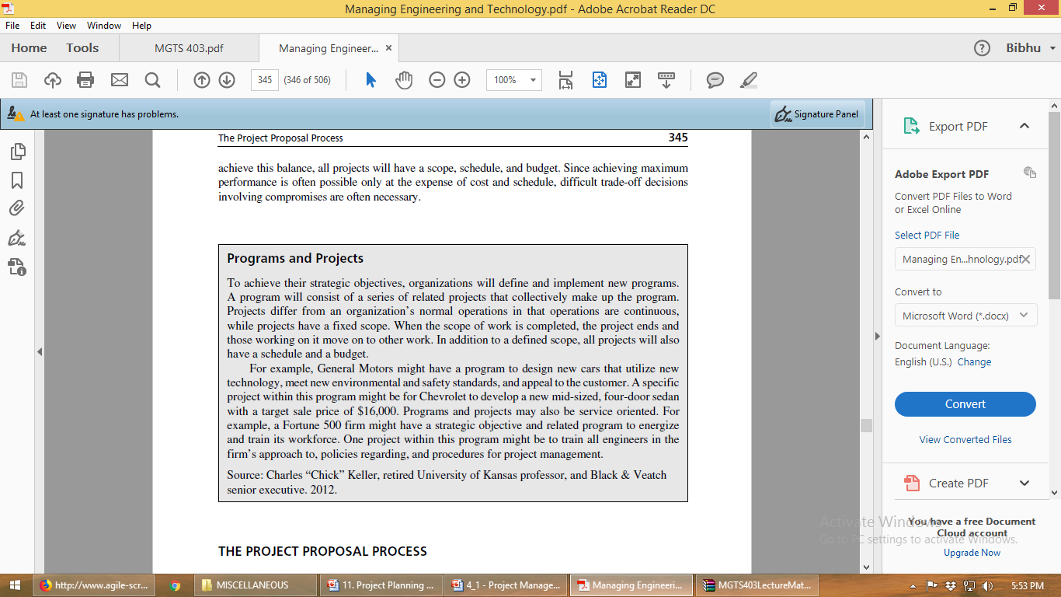

Slide 7
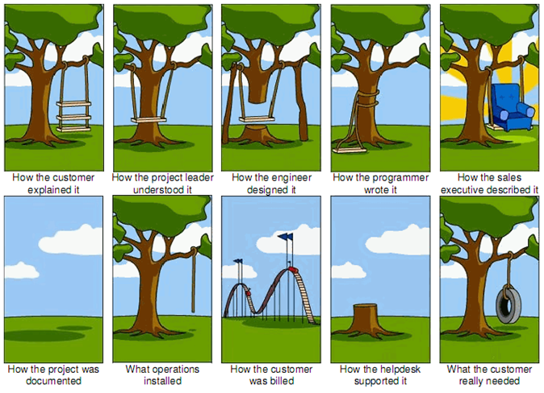
How Projects Really Works?

Slide 8
The Project Proposal Process
Pre-proposal Effort
Continuous identification of new business opportunities
Resources and capabilities
Expected future needs of potential customers
Proposal Preparation
Proposal Contents
The RFP (request for proposal) will often specify separate management, technical, and cost proposals and their expected contents

Slide 9
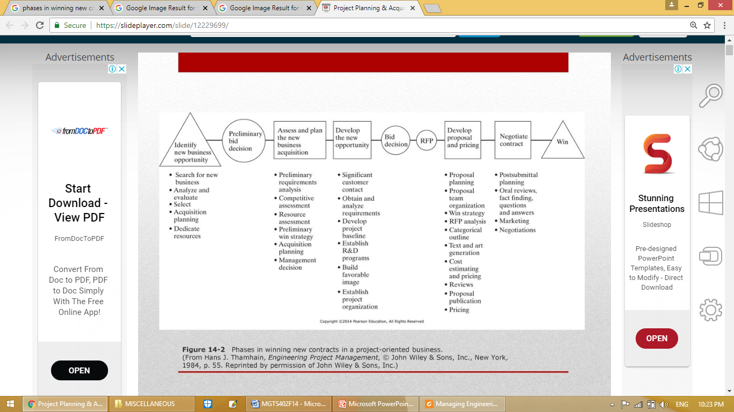

Slide 10
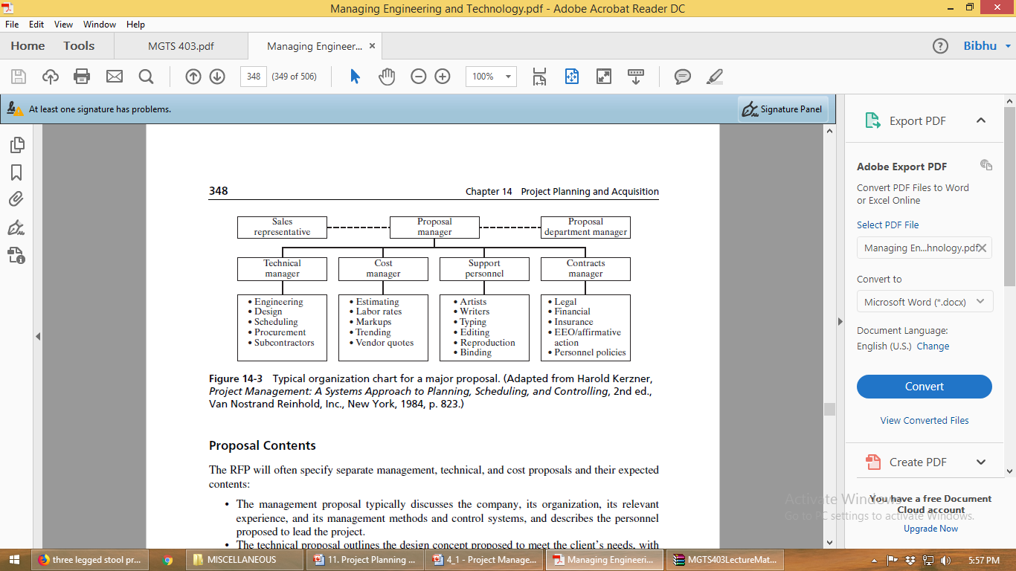

Slide 11
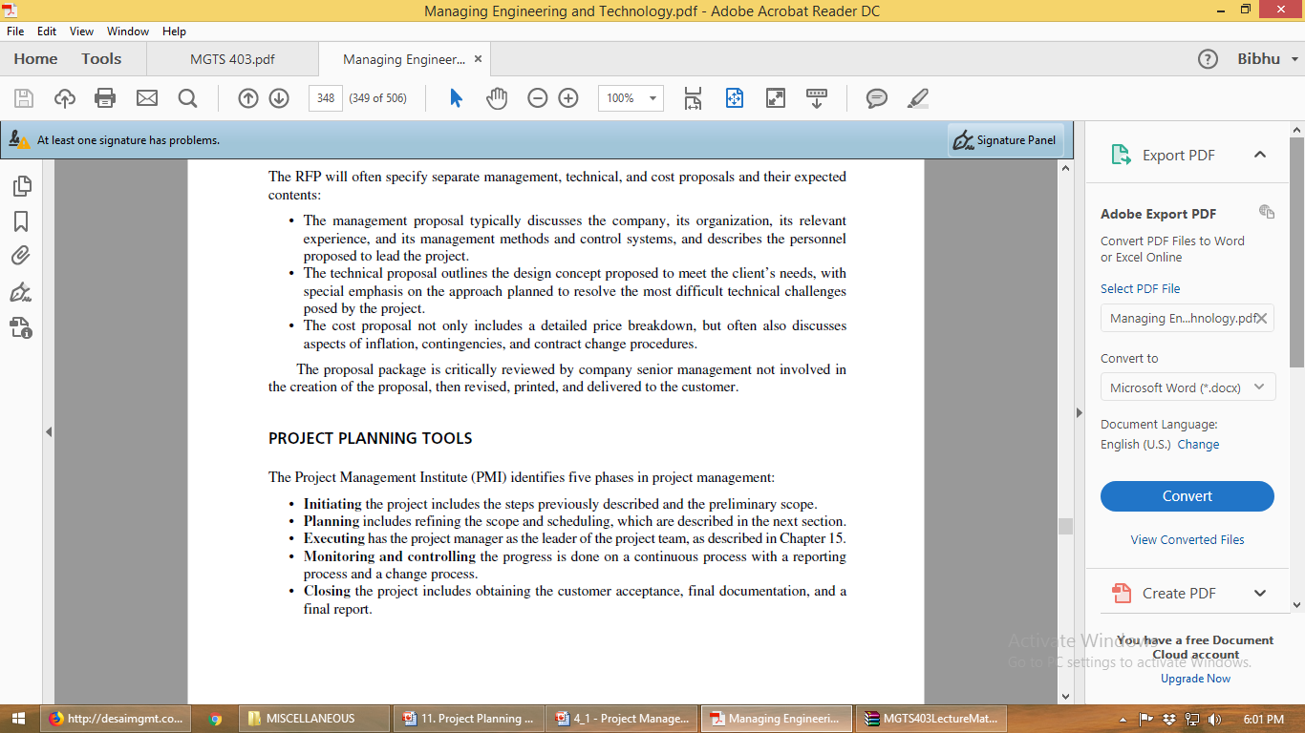
Project Planning Tools

Slide 12
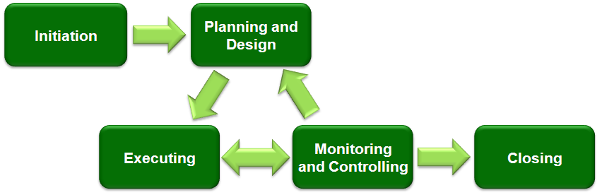

Slide 13
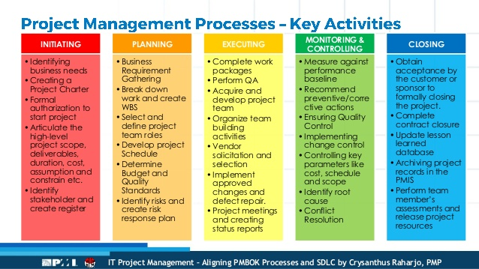

Slide 14
Three essential elements on every project plan: scope, schedule, and budget.
These elements are interdependent, and a change in one may cause a change in another to restore the balance of the project.
All of these elements are tied together by quality:
Quality of the deliverables of the project—do these deliverables meet the expectations of the customer?
Quality of the project process—how well does the project management process work, and how should it be improved?

Slide 15
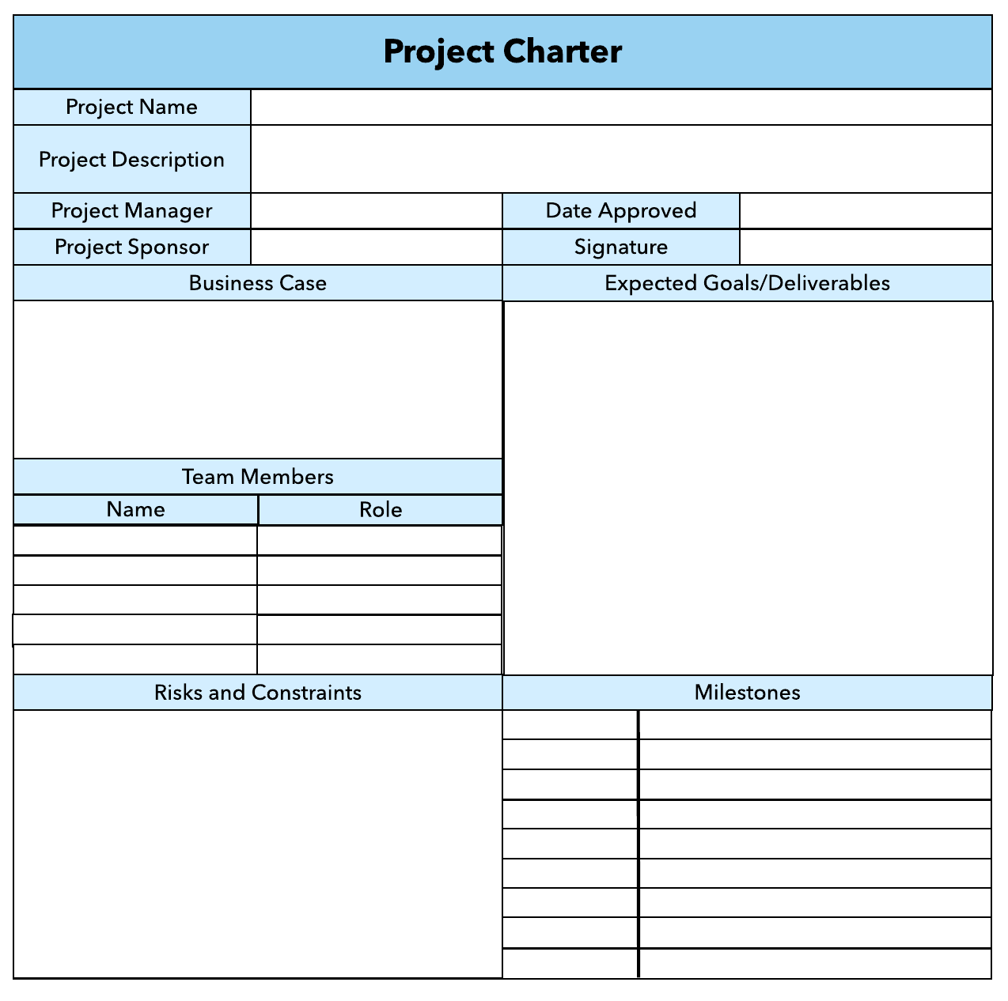

Slide 16
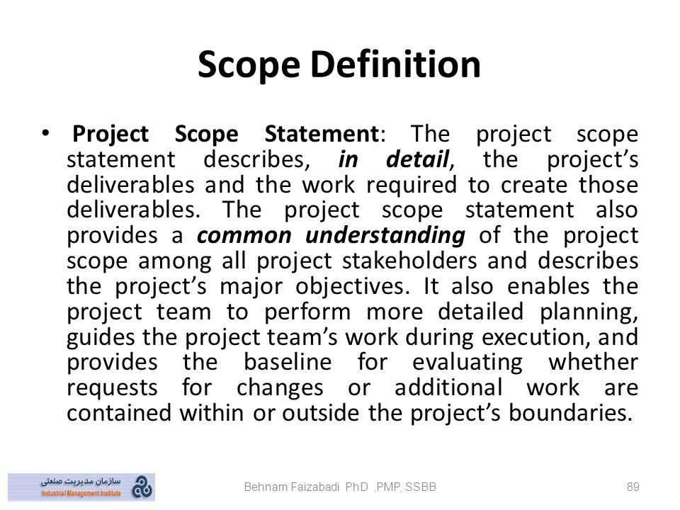
Scope

Slide 17
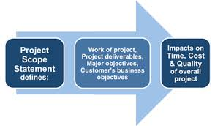
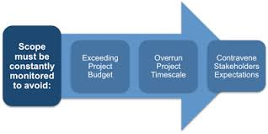

Slide 18
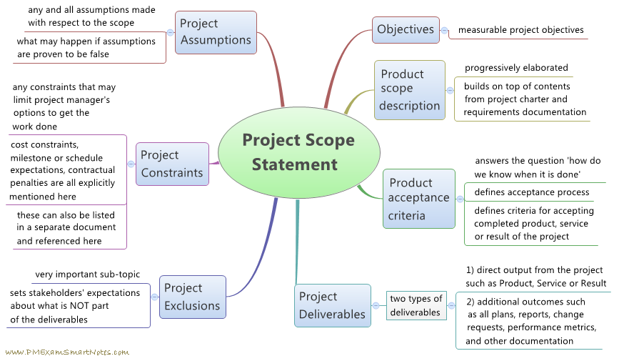

Slide 19

Scope creep is a term that refers to the incremental expansion of the scope of a project, which may include and introduce more requirements that may not have been a part of the initial planning of the project, while nevertheless failing to adjust schedule and budget.
Scope creep may happen in small projects, as well as large projects. Scope creep may be introduced by technologists adding features not originally contemplated.
Scope creep may also occur when the customer has a difficult time making a decision.

Slide 20
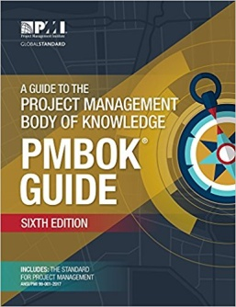
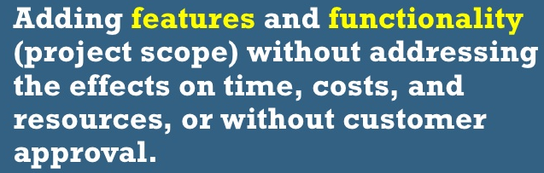
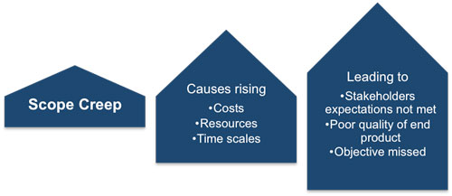

Slide 21
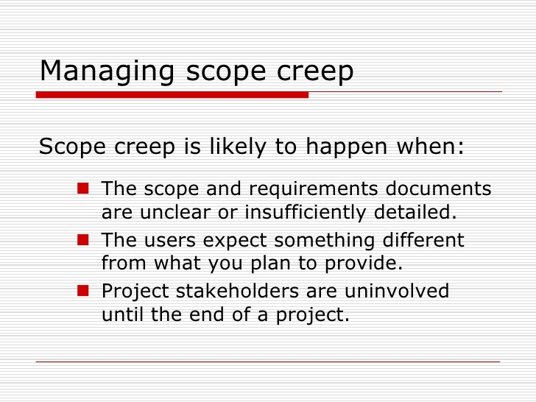

Slide 22
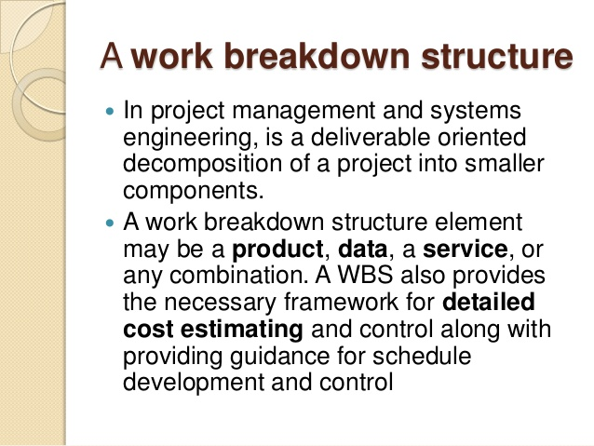
Schedule

Slide 23
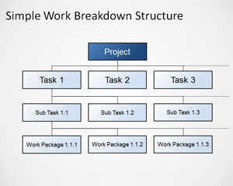

Slide 24
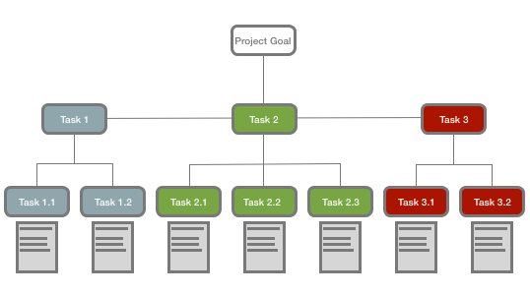

Slide 25
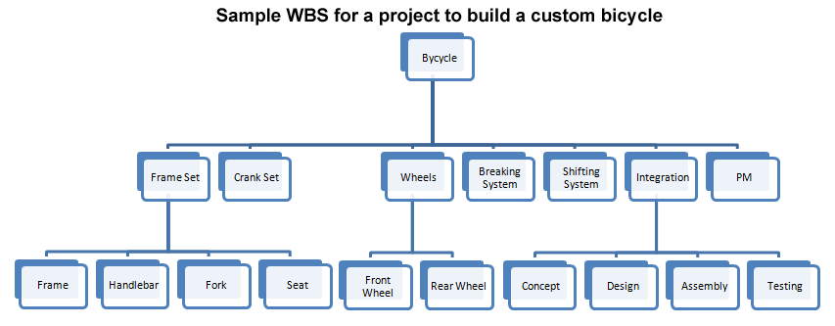
Sample WBS for Building a Custom Bicycle

Slide 26
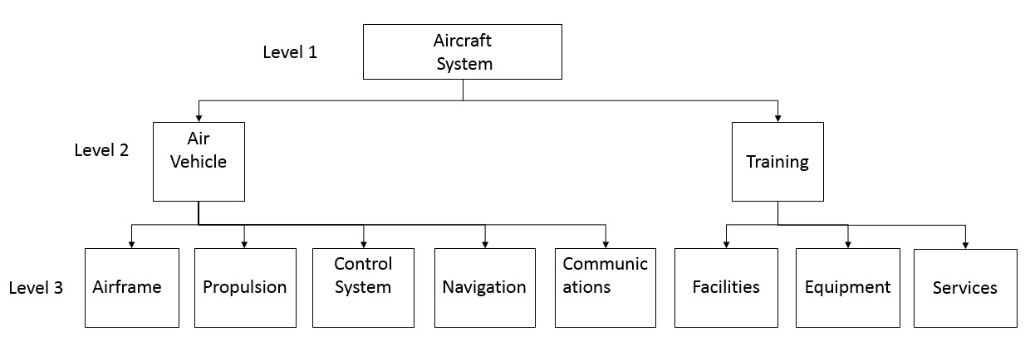

Slide 27
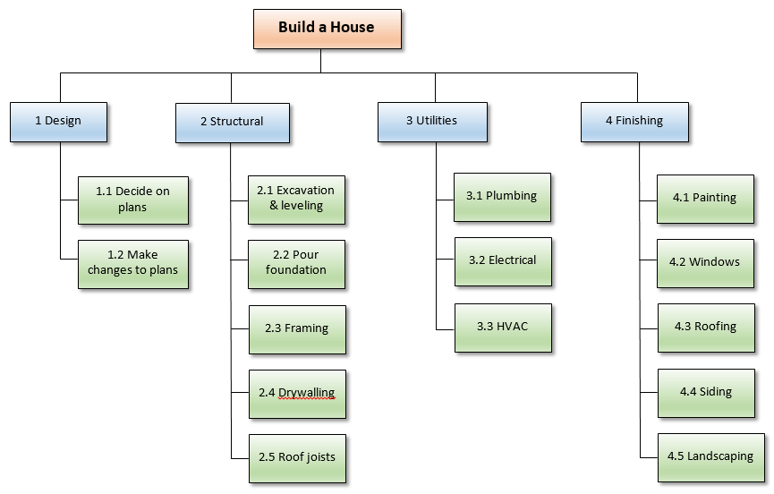

Slide 28
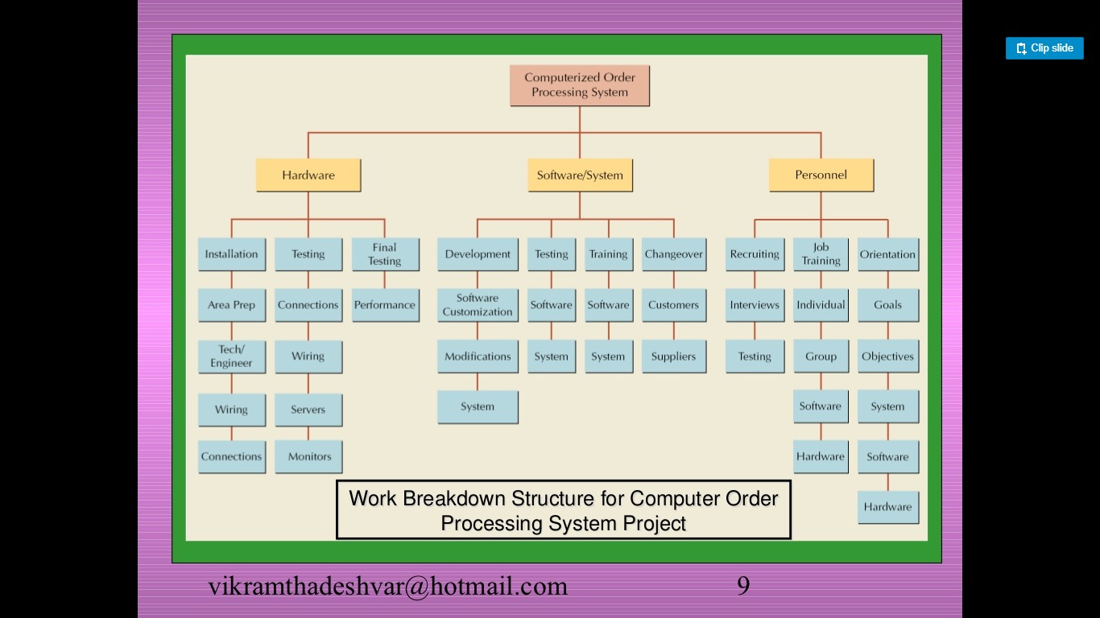

Slide 29
Planning House Project
Task | Follows Task(s) | Weeks Duration | Task Description
A | Start | 1.0 | Clear site
B | Start | 0.6 | Obtain Lumber and other materials
C | Start | 2.0 | Obtain other materials and components
D | B | 2.0 | Prefabricate wall panels
E | B | 0.8 | Prefabricate roof trusses
F | A,B | 1.0 | Form and pour footings and floor slab
G | D,F | 0.6 | Erect wall panels
H | E,G | 0.2 | Erect roof trusses
J | C,H | 0.6 | Complete roof
K | J | 2.0 | Finish interior
L | J | 1.0 | Finish exterior
M | L | 0.4 | Clean up site
N | K,M | 0.2 | Final inspection and approval
Consider a 5 day week.
8-hour day is 0.2 week

Slide 30
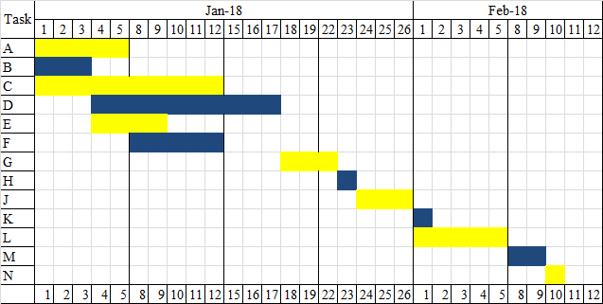
Gantt Chart
Gantt Charts are easy to understand and use, and they provide a good tool for managing small projects without an excessive number of tasks.

Slide 31
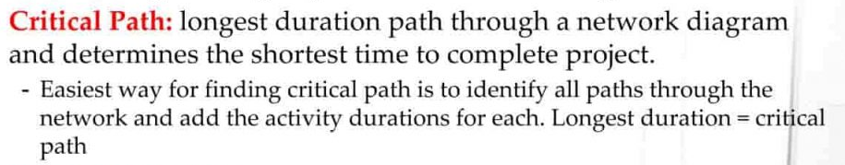
Network-Based Project Scheduling - CPM/PERT
CPM (Critical Path Method) determines the longest path and the critical activities along this path in a project network;
the project completion time can't be shorter than the duration of this longest path unless such techniques as time crashing are used.

Slide 32
PERT (Program Evaluation and Review Technique) incorporates probabilistic elements into the computation of activity durations and hence the project completion time;
PERT uses optimistic (o), most probable (m), and pessimistic (p) activity times to estimate the expected activity times.

Slide 33
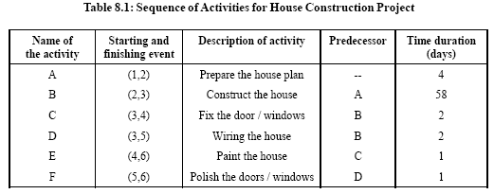
An Example Network Diagram – House Construction Project

Slide 34
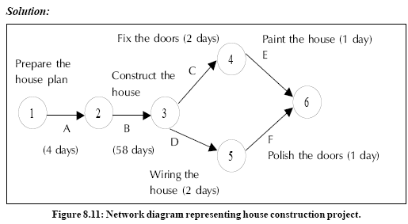

Slide 35
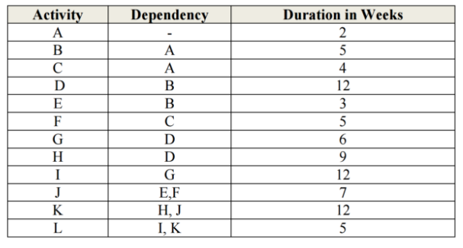

Slide 36
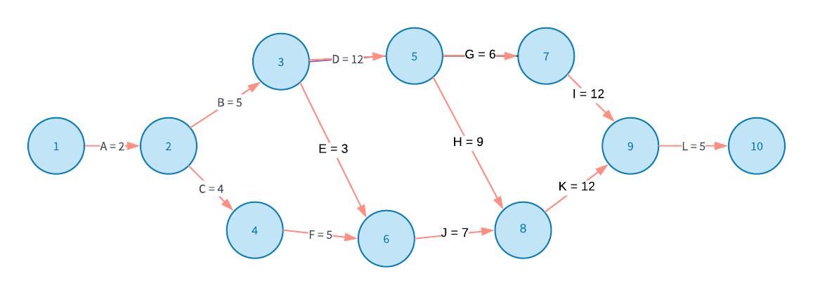

Slide 37
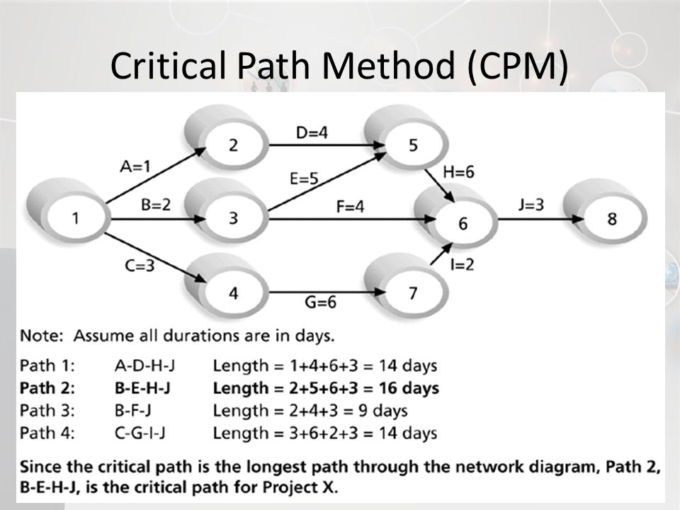

Slide 38
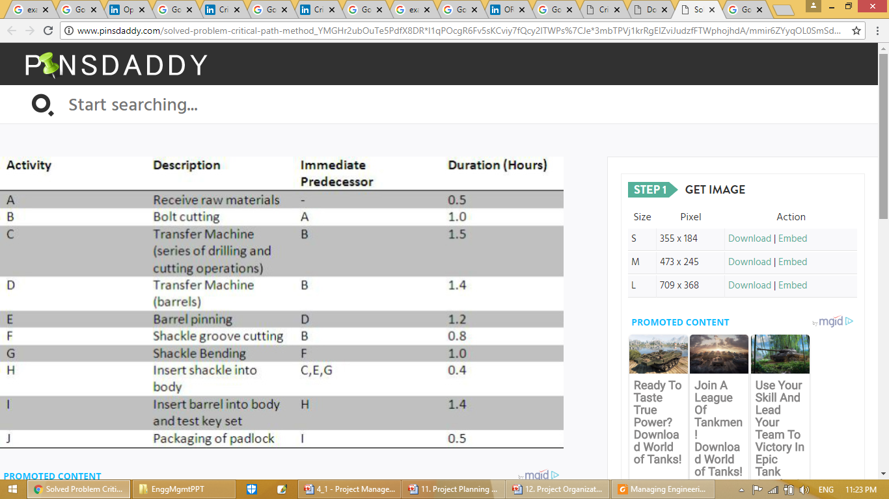

Slide 39
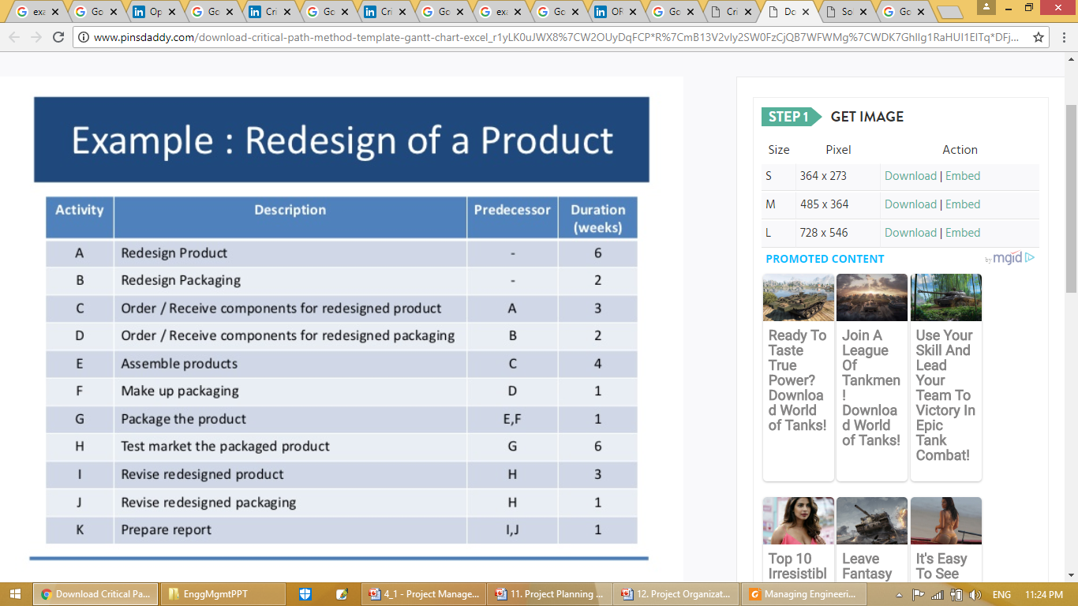

Slide 40
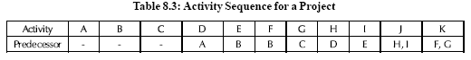
Construct a network for a project whose activities and their predecessor relationship are given below:

Slide 41
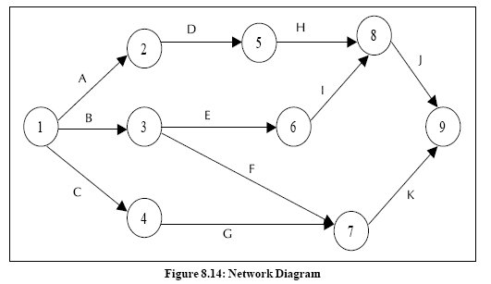
Solution:

Slide 42
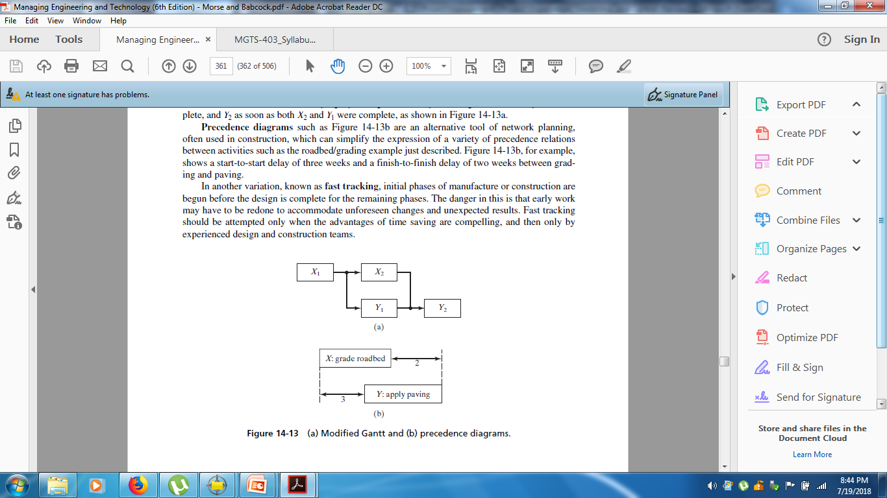
Controlling Cost and Schedule
Reducing Project Duration

Slide 43
Crashing the Project
Crashing is the technique to use when fast tracking has not saved enough time on the schedule. It is a technique in which resources are added to the project for the least cost possible. Cost and schedule tradeoffs are analyzed to determine how to obtain the greatest amount of compression for the least incremental cost.

Slide 44
In crashing you add extra resources to the project to compress the schedule. You review the critical path and see which activities can be completed by adding extra resources. You try to find the activities that can be reduced the most by adding the least amount of cost. Once you find those activities, you will apply the crashing technique.

Slide 45
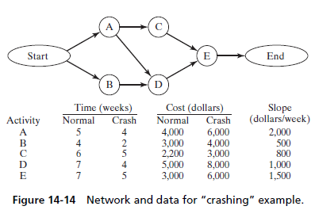

Slide 46
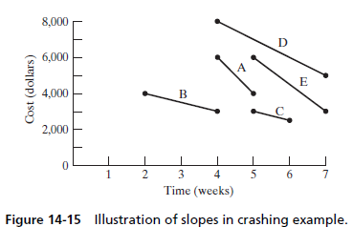

Slide 47
Earned Value System
In a nutshell, Earned Value is an approach where you monitor the project plan, actual work, and work completed value to see if a project is on track.
Earned Value Management System (EVMS) — the process, procedures, tools, and templates used by an organization to do earned value management.

Slide 48
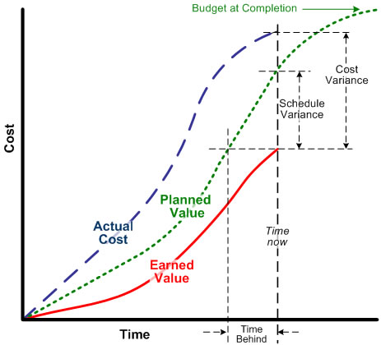

Slide 49
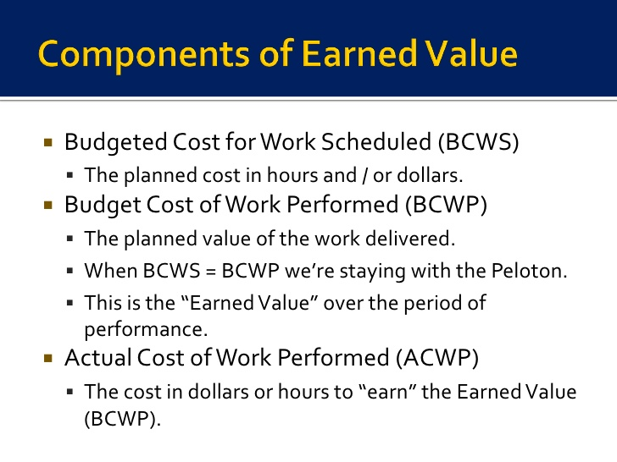

Slide 50
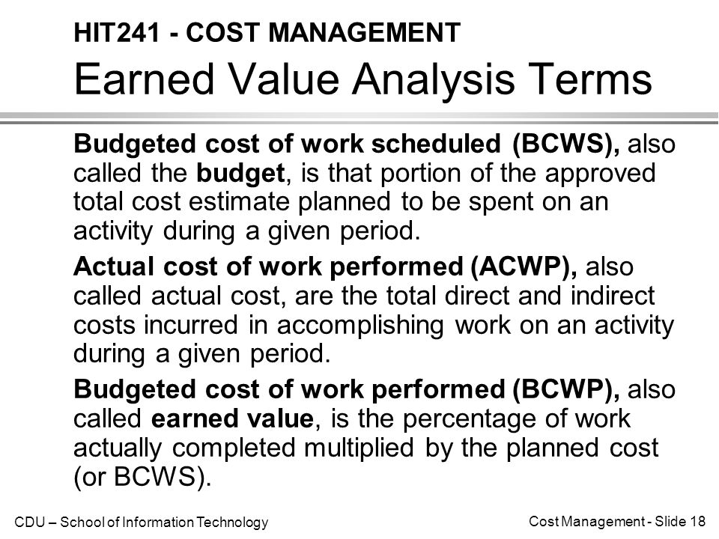

Slide 51
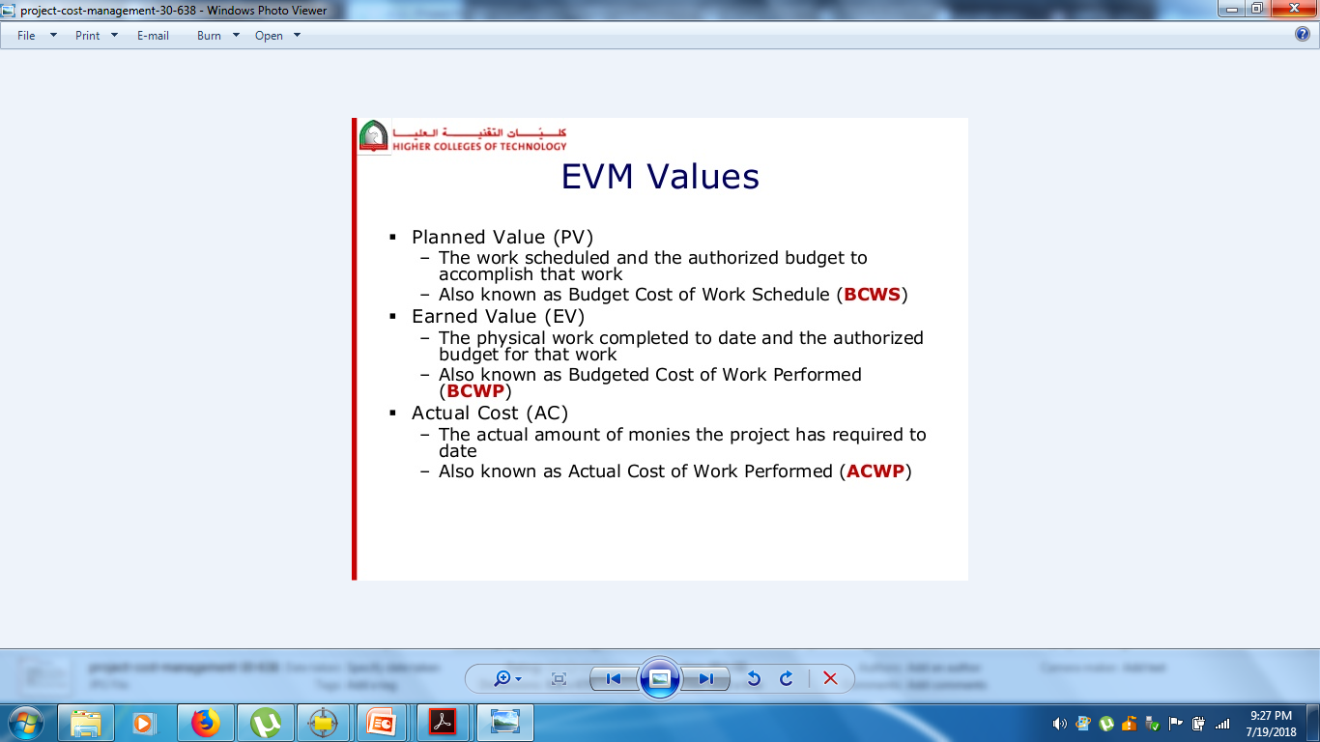

Slide 52
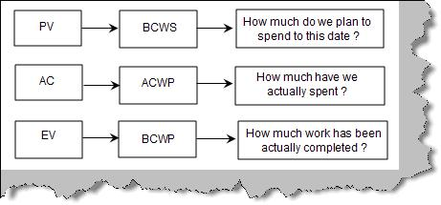

Slide 53
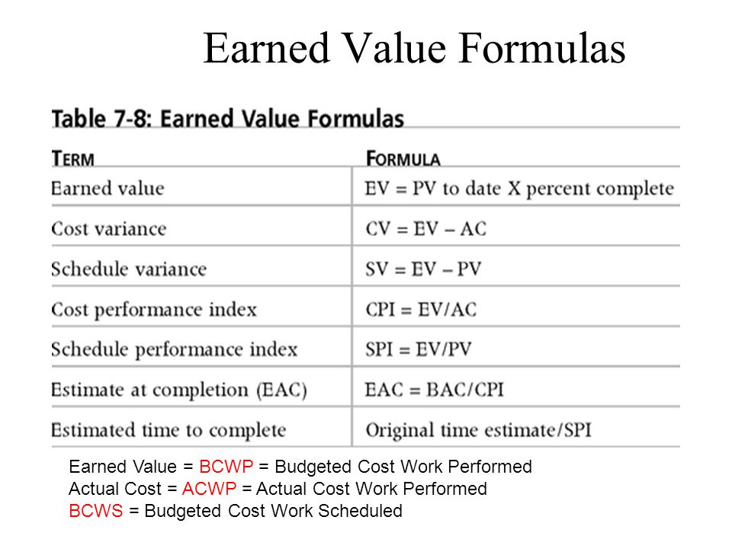

Slide 54
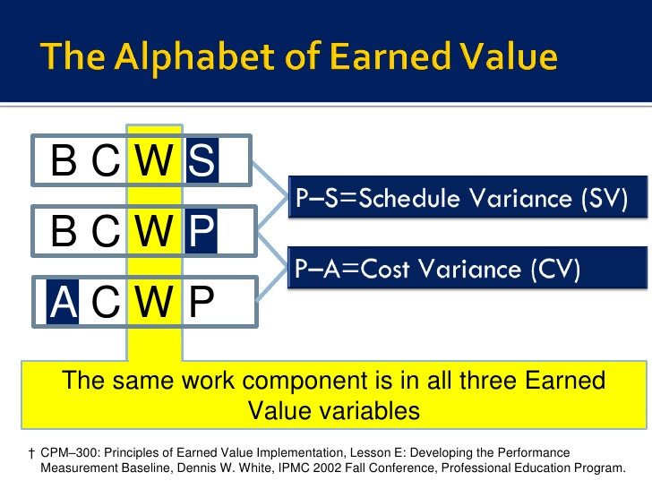

Slide 55
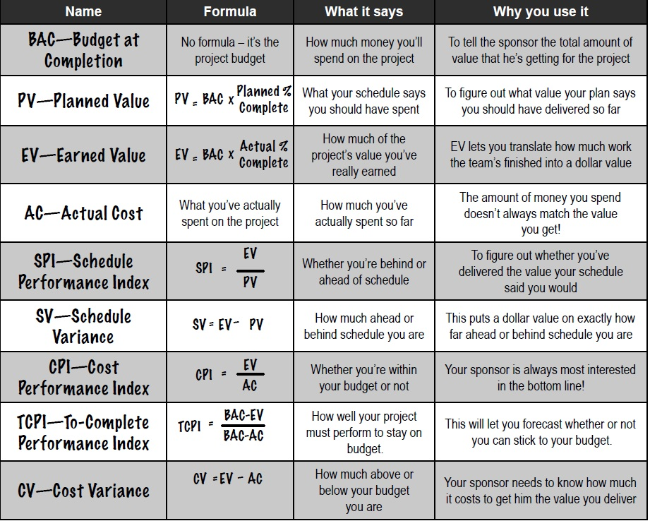

Slide 56
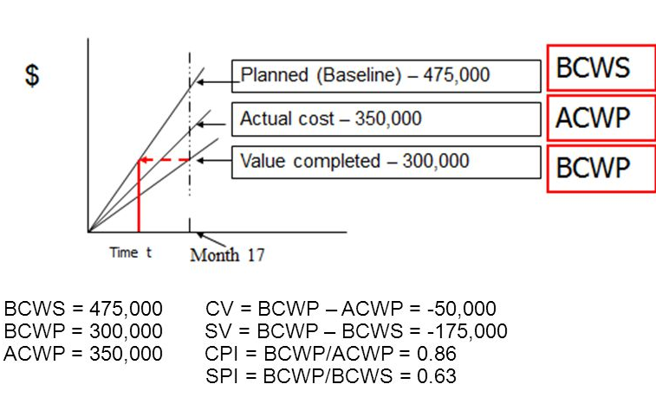
Example

